Slide 1

End-to-End Key word Spotting
Students:
Ivancich Stefano
Masiero Luca
Supervisor:
Rossi Michele
22 September 2020

Slide 2
Outline
The Problem
The Solution
What we tried
Architecture 1: 1D CNN on RAW data
Architecture 2: DSConv
Architecture 3: Ensemble
Performance comparison against other papers
Conclusions
Ivancich S. - Masiero L.
22 September 2020
1

Slide 3
The Problem
Key word spotting:
Detect a relatively small set of predefined keywords (10 or 21) in a stream of user utterances.
Application: Mobile phone, smart home device, consumer and robotics applications.
Real Time.
Metrics:
Accuracy
# of parameters
Prediction speed (milliseconds)
Ivancich S. - Masiero L.
22 September 2020
2

Slide 4
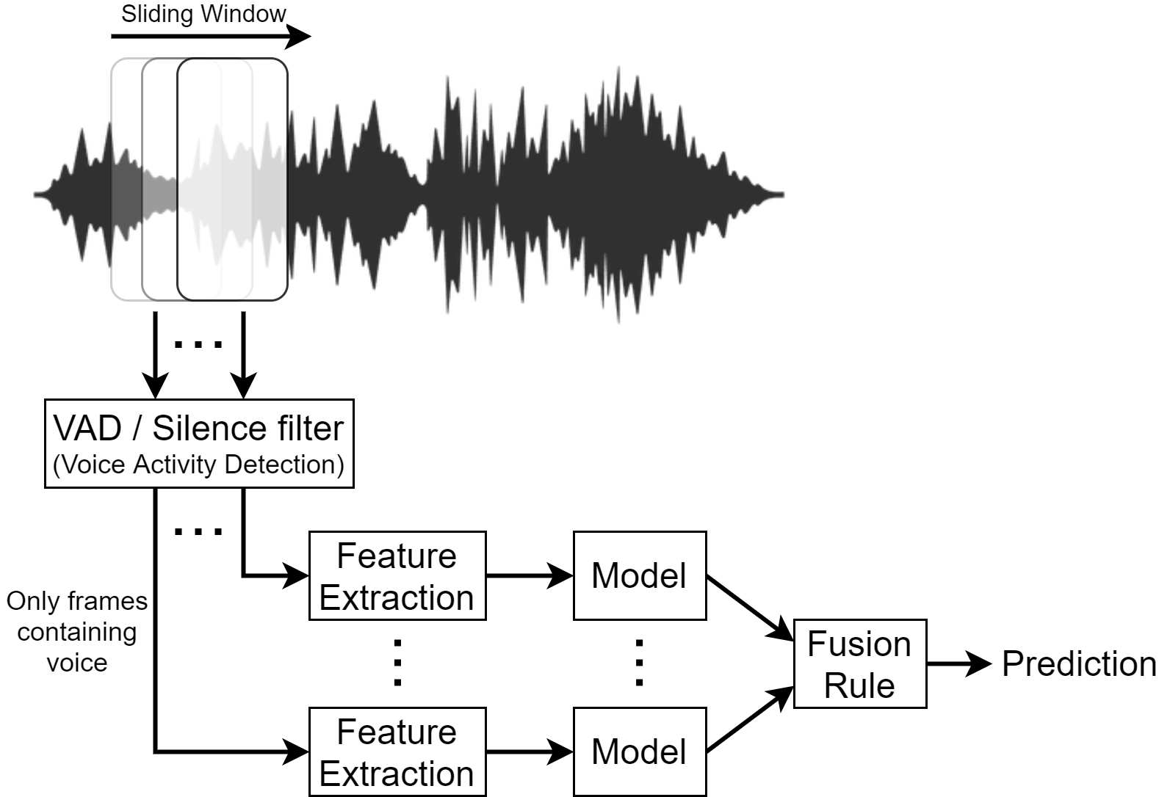
The Solution
Ivancich S. - Masiero L.
22 September 2020
3
Notes:
The input audio waveform X is split into S frames.
It is to computational expensive to use the model for each frame. So we can use a VAD (Voice Activity Detection) or Silence filter to let the model process just the frames that contains voice.
This component must be very compact, low computational expensive and very fast, like just ignoring anything under 40db, it can be a piece of software or even a little piece hardware like some home device are using nowdays.
We need to aggregate the CNN predictions to come up to a decision on X.
Fusion rules can be used to reach a ﬁnal decision, such as the majority vote

Slide 5
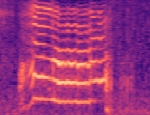
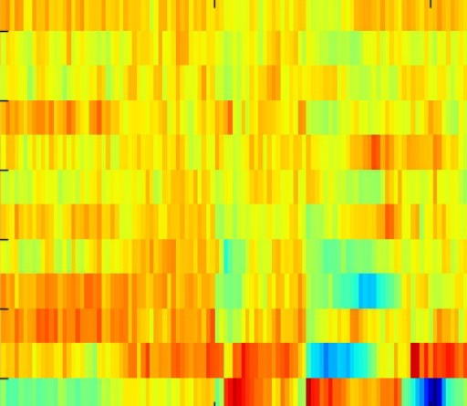
What we tried
Datasets:
10 commands (yes, no, up, down, left, right, on, off, stop, go)
21 commands (…, zero, one, two, three, four, five, six, seven, eight, nine, unknown)
Data Preprocessing techniques:
No preprocessing (Raw Waveform)
80 Mel spectrogram
40 MFCC
40 MFCC + 40delta + 40deltadelta (=120)
Learning Architectures:
1D CNN on RAW data
DSConv (Small-Medium-Large)
Ensemble
Ivancich S. - Masiero L.
22 September 2020
4

Slide 6
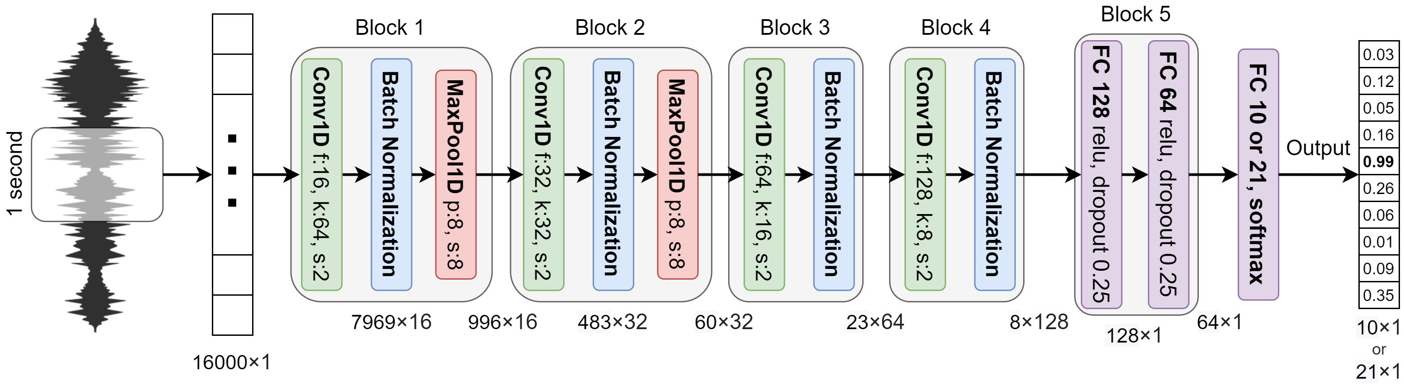
1D CNN on RAW data
 | 10 commands (30k - 3k - 3k) | 21 commands (84k - 9k - 11k)
Accuracy | 93.0 | 89.1
# parameters | 257,018 | 257,733
Speed (ms) | 28.71 | 28.25
Ivancich S. - Masiero L.
22 September 2020
5
Notes:
Input an array of 16,000 dimensions, which represents 1-second of audio sampled at 16kHz.
The architecture is composed of 4 convolutional layers, possibly interlaced with max pooling layers, followed by 2 fully connected layers and an output layer.
In order to reduce the over-fitting, batch normalization is applied after the activation function of each convolution layer.
after the last pooling layer, there are two fully connected layers with 128 and 64 neurons respectively on which a drop-out is applied with a probability of 0.25 for both layers.

Slide 7
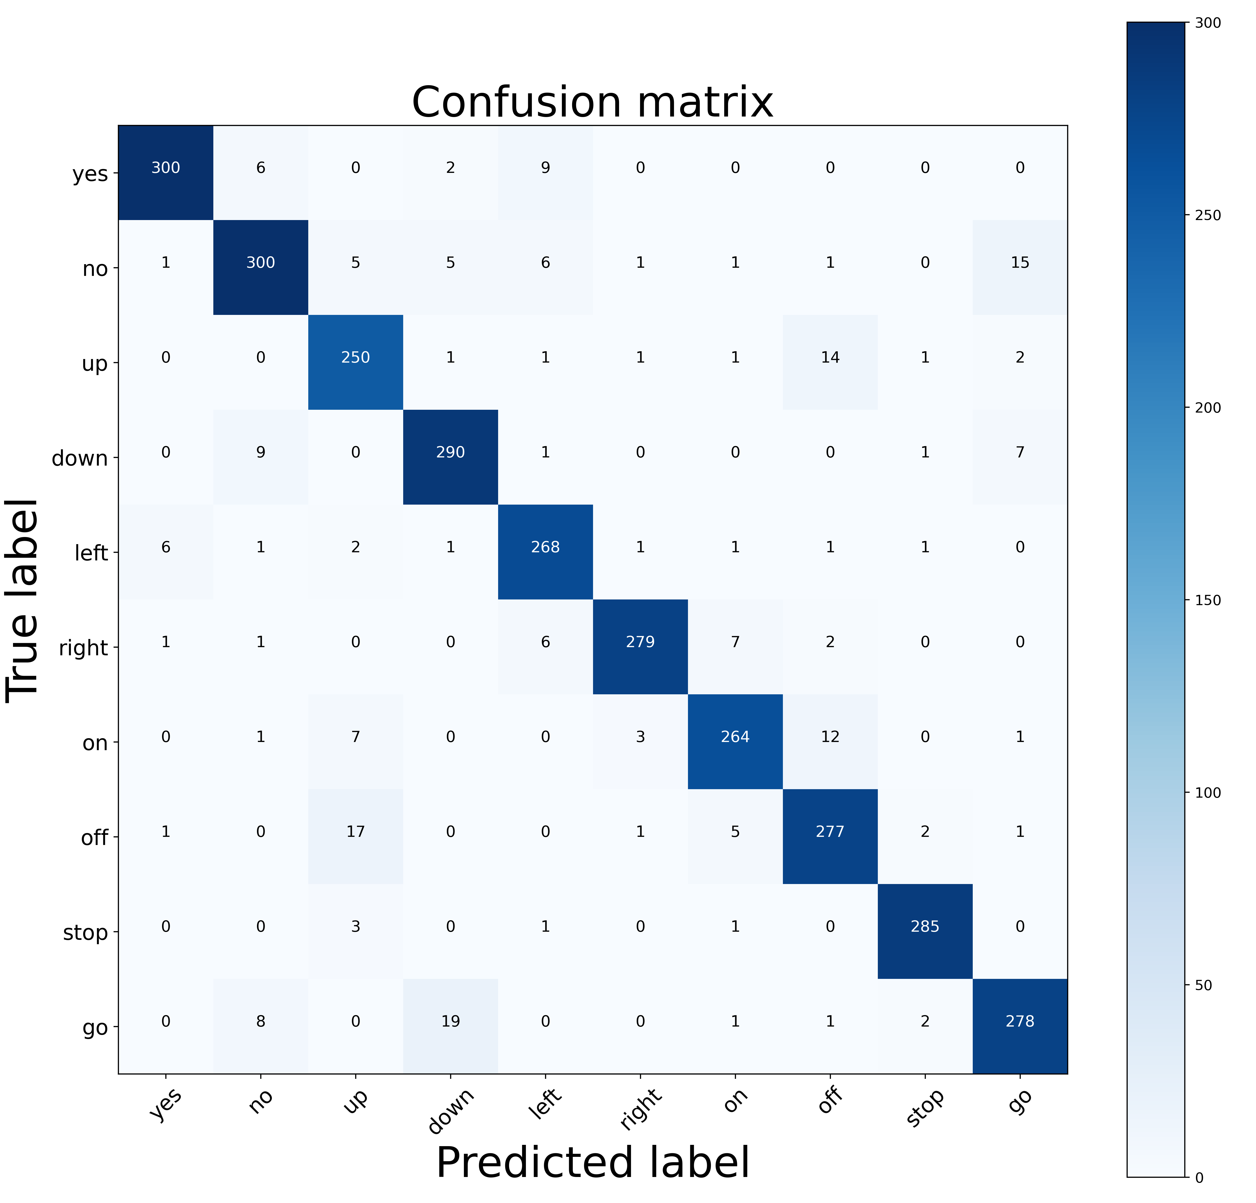
1D CNN on RAW data
Ivancich S. - Masiero L.
22 September 2020
6
Notes:
Input an array of 16,000 dimensions, which represents 1-second of audio sampled at 16kHz.
The architecture is composed of 4 convolutional layers, possibly interlaced with max pooling layers, followed by 2 fully connected layers and an output layer.
In order to reduce the over-fitting, batch normalization is applied after the activation function of each convolution layer.
after the last pooling layer, there are two fully connected layers with 128 and 64 neurons respectively on which a drop-out is applied with a probability of 0.25 for both layers.

Slide 8
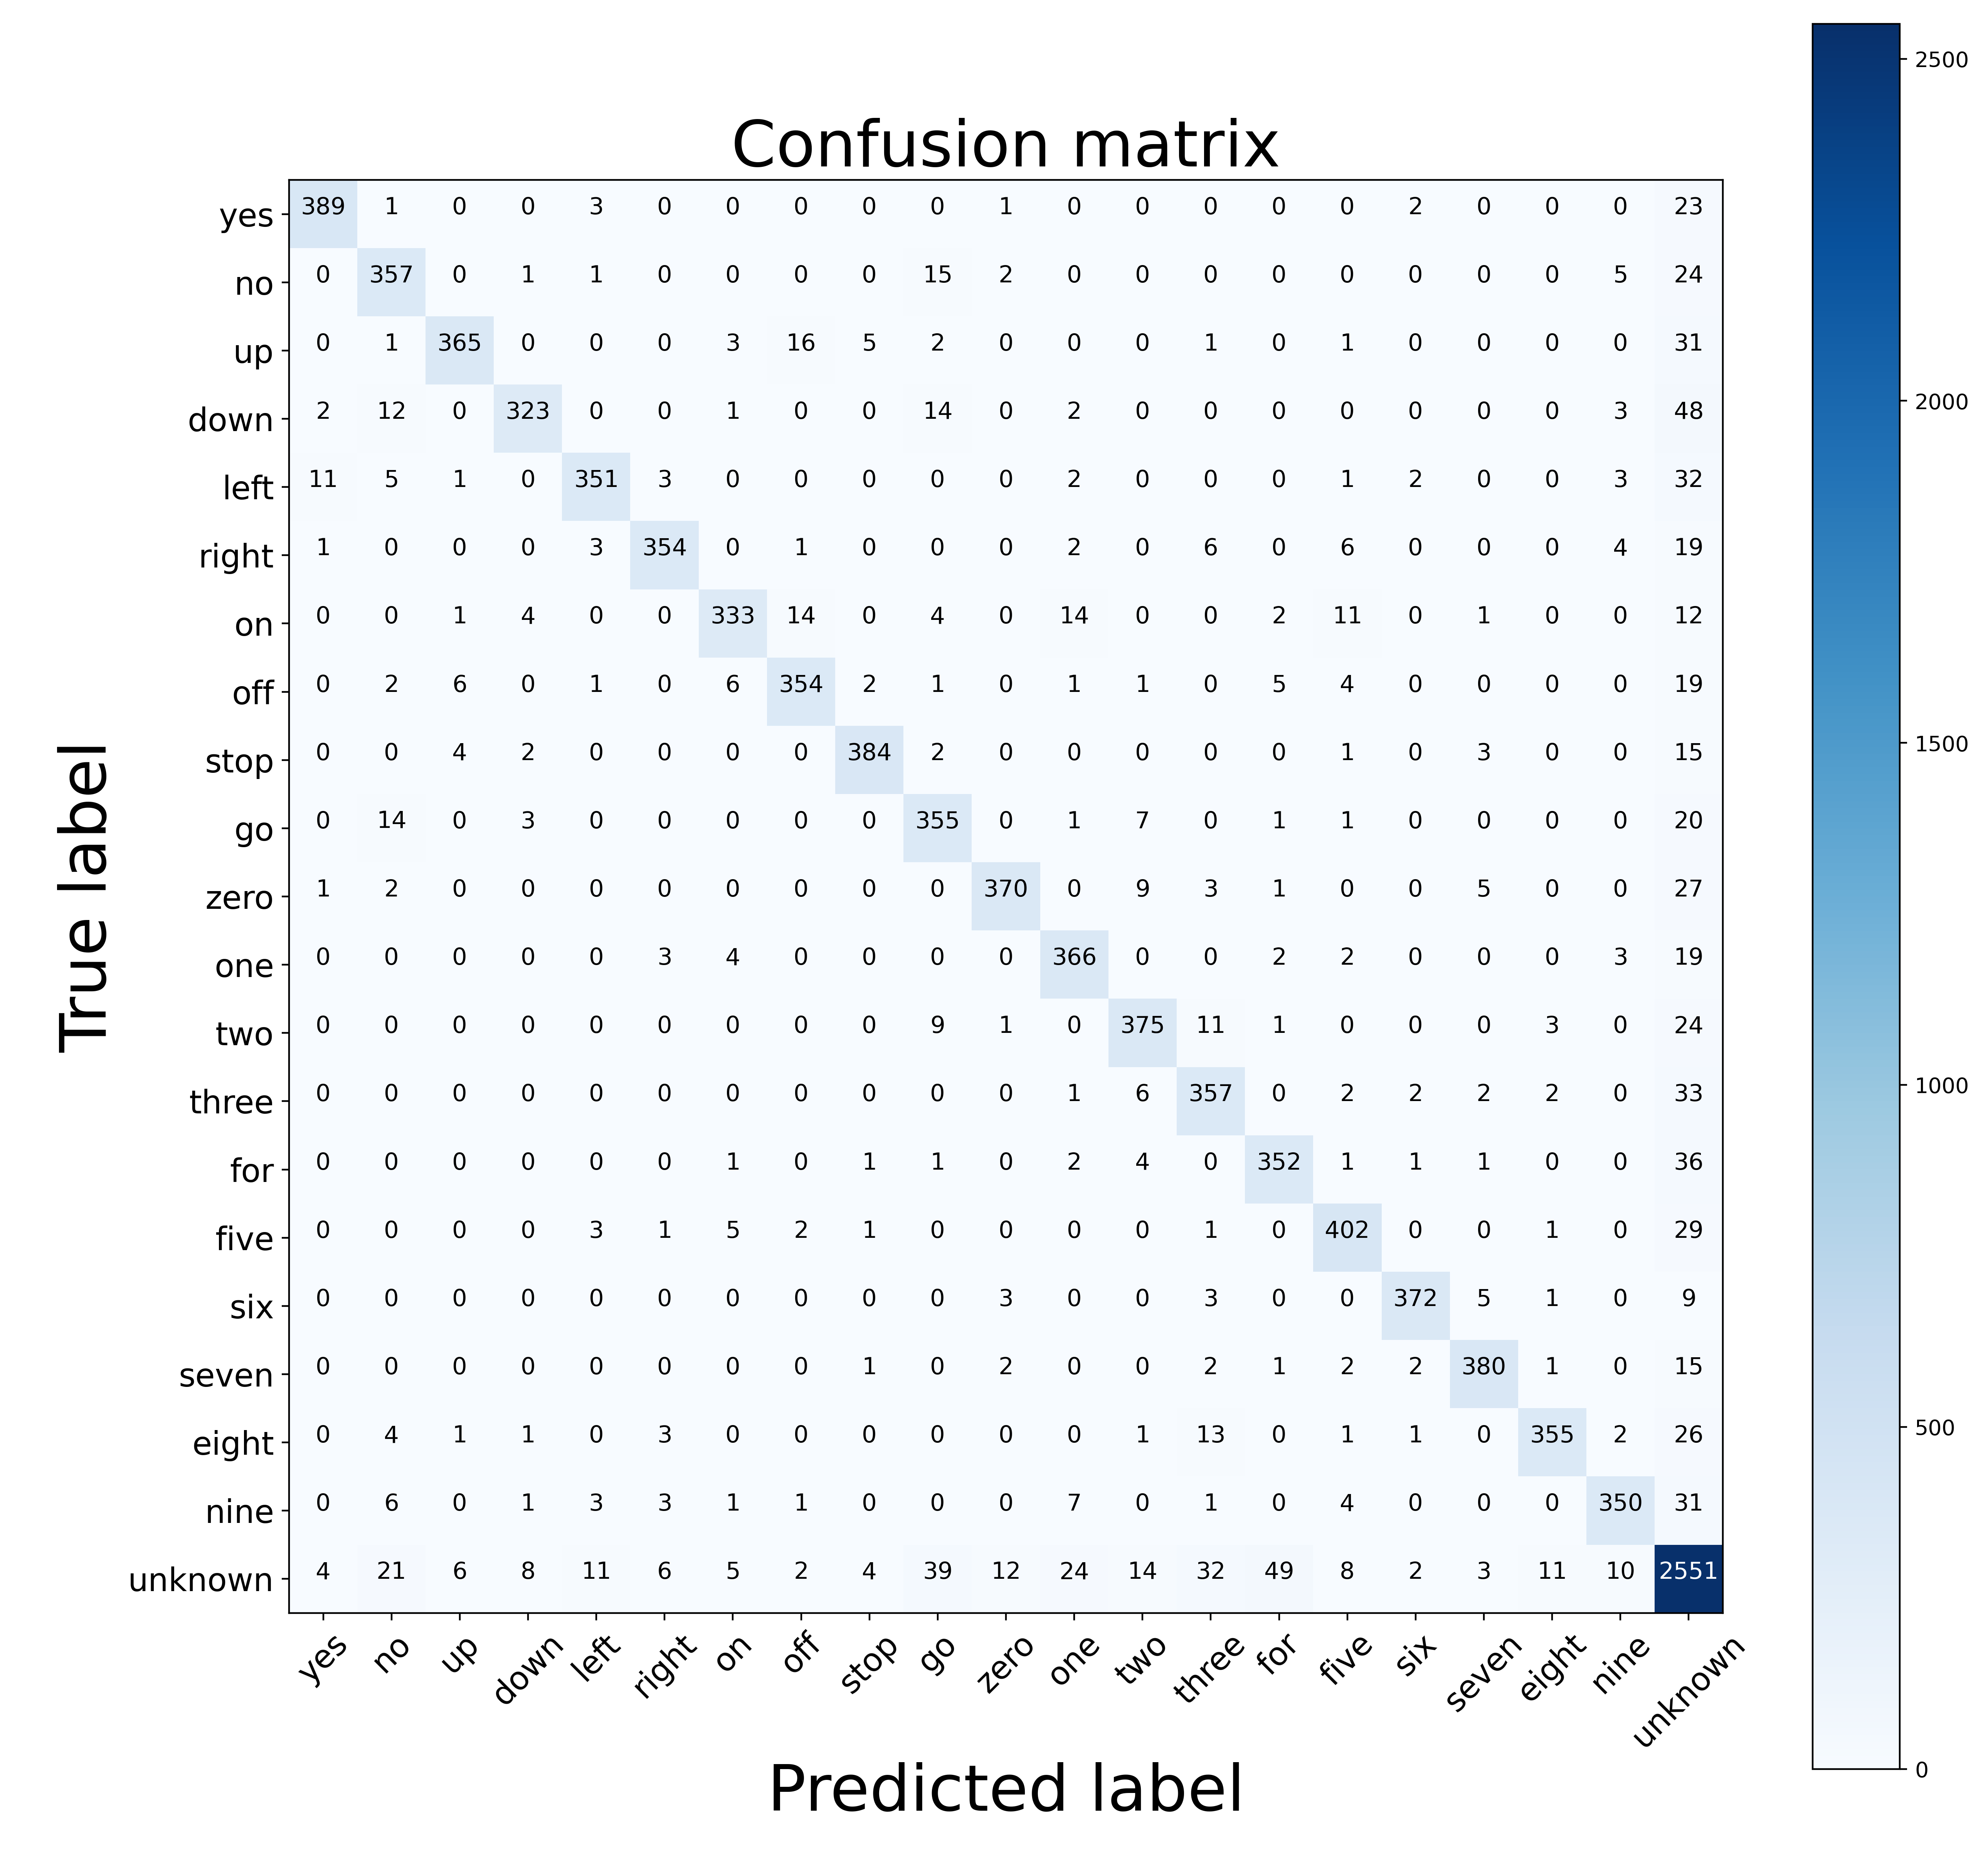
1D CNN on RAW data
Ivancich S. - Masiero L.
22 September 2020
7
Notes:
Input an array of 16,000 dimensions, which represents 1-second of audio sampled at 16kHz.
The architecture is composed of 4 convolutional layers, possibly interlaced with max pooling layers, followed by 2 fully connected layers and an output layer.
In order to reduce the over-fitting, batch normalization is applied after the activation function of each convolution layer.
after the last pooling layer, there are two fully connected layers with 128 and 64 neurons respectively on which a drop-out is applied with a probability of 0.25 for both layers.

Slide 9
Separable CONV
Separable convolution: uses less parameters, less memory and less computations than regular convolutional layers, and perform better.
There are two types of Separable convolution: Spatial and depthwise
Spatial separable convolution: divides a kernel into two, smaller kernels.
E.g. divide a 3x3 kernel into a 3x1 and 1x3 kernel. So, instead of doing one convolution with 9 multiplications, we do two convolutions with 3 multiplications each (6 in total) to achieve the same effect.
Problem: not all kernels can be “separated” (mathematically) into two.
Depthwise Separable convolution: uses kernels that cannot be “factored” into two smaller kernels. It deals not just with the spatial dimensions, but also with the depth dimension (number of channels).
Splits a kernel into 2 separate kernels that do two convolutions:
the depthwise convolution
the pointwise (1x1) convolution.
Ivancich S. - Masiero L.
22 September 2020
8

Slide 10
Depth-wise Sep. CONV
Ivancich S. - Masiero L.
22 September 2020
9

Slide 11
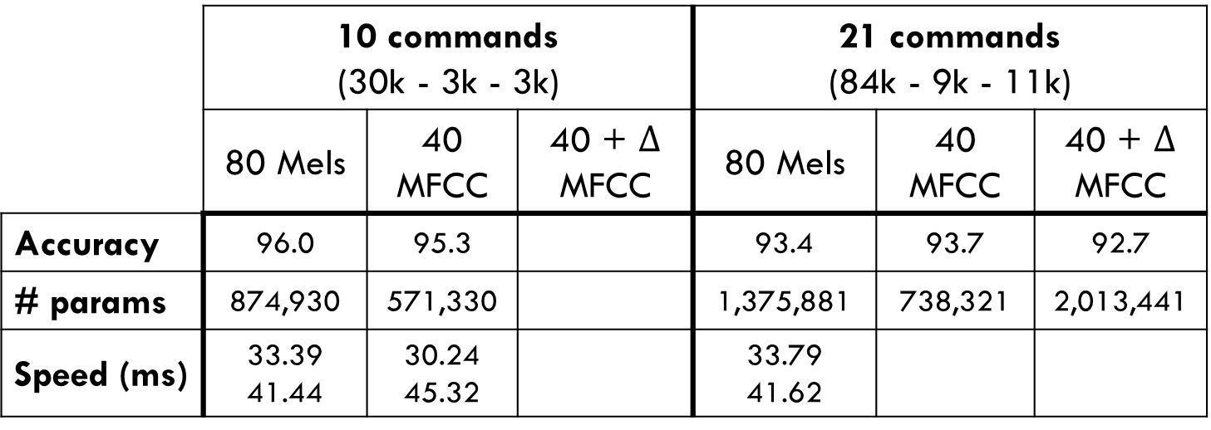
DSConv Model - Large
 | 10 commands (30k - 3k - 3k) |  |  | 21 commands (84k - 9k - 11k)
 | 80 Mels | 40 MFCC | 40 + $Δ$ MFCC | 80 Mels | 40 MFCC | 40 + $Δ$ MFCC
Accuracy | 96.0 | 95.3 |  | 93.4 | 93.7 | 92.7
# params | 874,930 | 571,330 |  | 1,375,881 | 738,321 | 2,013,441
Speed (ms) | 33.39 41.44 | 30.24 45.32 |  | 33.79 41.62
Ivancich S. - Masiero L.
22 September 2020
10

Slide 12
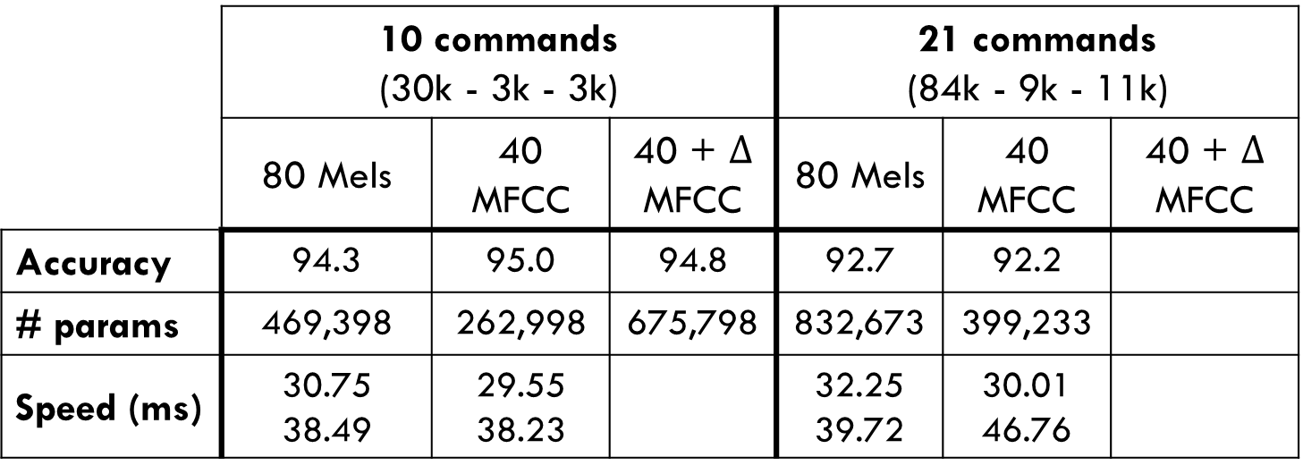
DSConv Model - Medium
 | 10 commands (30k - 3k - 3k) |  |  | 21 commands (84k - 9k - 11k)
 | 80 Mels | 40 MFCC | 40 + $Δ$ MFCC | 80 Mels | 40 MFCC | 40 + $Δ$ MFCC
Accuracy | 94.3 | 95.0 | 94.8 | 92.7 | 92.2
# params | 469,398 | 262,998 | 675,798 | 832,673 | 399,233
Speed (ms) | 30.75 38.49 | 29.55 38.23 |  | 32.25 39.72 | 30.01 46.76
Ivancich S. - Masiero L.
22 September 2020
11

Slide 13
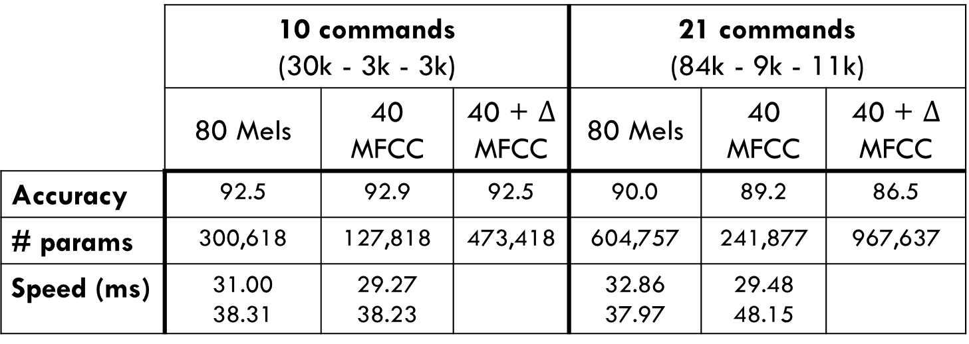
DSConv Model - Small
 | 10 commands (30k - 3k - 3k) |  |  | 21 commands (84k - 9k - 11k)
 | 80 Mels | 40 MFCC | 40 + $Δ$ MFCC | 80 Mels | 40 MFCC | 40 + $Δ$ MFCC
Accuracy | 92.5 | 92.9 | 92.5 | 90.0 | 89.2 | 86.5
# params | 300,618 | 127,818 | 473,418 | 604,757 | 241,877 | 967,637
Speed (ms) | 31.00 38.31 | 29.27 38.23 |  | 32.86 37.97 | 29.48 48.15
Ivancich S. - Masiero L.
22 September 2020
12

Slide 14
Ensemble
Ensemble between the best
10 commands:
DSConvLarge MFCC + DSConvLarge Mels = 96,6
20 commands:
,,,
Ivancich S. - Masiero L.
22 September 2020
8

Slide 15
Performances
 | Accuracy % | Parameters | Prediction speed
SincConv+DSConv | 97,3 | 66K
ATTNN | 96,9 | 202K
OURS
Ivancich S. - Masiero L.
22 September 2020
13

Slide 16
Conclusions
Conclusions:
The tests showed that our model was very good at classify keywords.
Unfortunately we didn’t beat the state-of-the-art models,
Future Work:
Try different hyper-parameters during training
Change the structure of the network using:
SinvConv
GDSConv
Different features extraction
Build a Feature extractor with convolutional autoencoder
Ivancich S. - Masiero L.
22 September 2020
14

Slide 17
Thank You
Thanks for your attention!
Any questions?
Ivancich S. - Masiero L.
22 September 2020
15

Slide 18
How we have tackled it
1) Literature from:
Teacher’s material
ArchiveX
paperswithcode.com
Reddit
GitHub
Paper’s references
2) For each paper:
What we find useful for our problem?
Which references we want to follow?
1D CNN
Attention
40 MFCC
DSConv
…
Ivancich S. - Masiero L.
20 July 2020
3

Slide 19

How we have tackled it
3) Try to mix from things written down
Example:
Paper X says that MFCC are good for human voice …
Paper Y says that DSConv are faster than normal CNN …
Mixing X and Y will work?
4 ) Debugging:
Bias vs Variance
Error Analysis: look at the misclassified examples
Why didn’t work? When explaining we discovered other things to try
40 MFCC
DSConv
Ivancich S. - Masiero L.
20 July 2020
4

Slide 20
Architecture
A key challenge in applying CNNs is that sufficient training data are not always available in medical images. To avoid Over/Under-fitting:
Data Augmentation: In case of medical images this often comes down to mirror flipping, small-magnitude translations, weak Gaussian blurring, brightness augmentation and shadow augmentation.
TransferLearning from AlexNet: training CNN from scratch is usually challenging owing to the limited amount of labeled medical data. A promising alternative is to fine-tune the weights of a network that was trained using a large set of labeled natural images.
Prof. Tajbakhsh, Illinois Institute of Technology: considered several medical imaging applications and investigated how the performance of CNNs trained from scratch compared with the pre-trained CNNs. Their experiments demonstrated that pretrained CNNs performed better than CNN trained from scratch.
Ivancich Stefano
15 July 2019
9

Slide 21
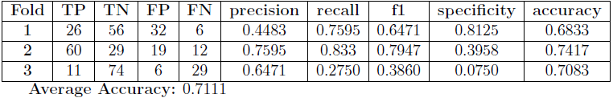
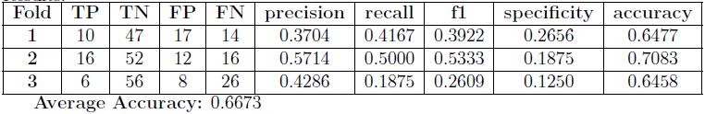
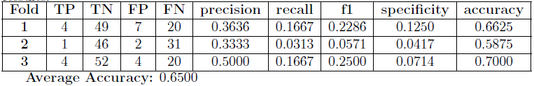
Performances
Due to the lack of memory (RAM) and computational power given to us, as we were undergraduate students: Instead of converting each MRI in 100 pictures, we have extracted only 8 pictures for each MRI, Trained on 3 folds instead of 20, haven’t performed any data augmentation. However, our supervisor will execute more exhaustive tests.
CN vs AD:
CN vs MCIc:
MCInc vs MCIc:
Ivancich Stefano
15 July 2019
10

